Slide 1
Prediction of Cephalopelvic Disproportion Using Machine Learning Based on Anthropometric Measurements
Anik Bhaumik(21MCA1134)
Guided By
Dr. Sandhya P

Slide 2
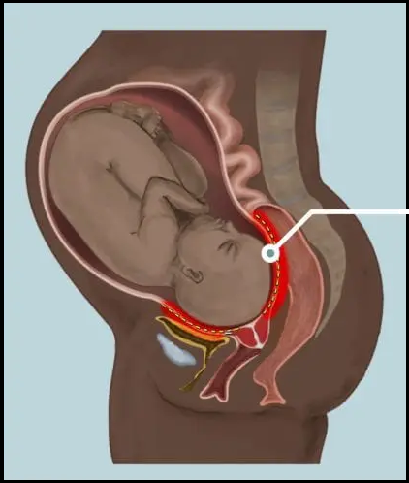
CEPHALOPELVIC DISPROPORTION (CPD)
CPD is a pregnancy complication in which there is a size mismatch between the mother's pelvis and the head of the baby
CPD can stall or completely halt vaginal delivery, making it dangerous or impossible to have normal delivery, if an attempted vaginal delivery is unsuccessful doctors should quickly move onto a C-section
Thu Jan 06 2022 00:13:04 GMT-0600 (Central Standard Time)

Slide 3
WHAT CAUSES CEPHALOPELVIC DISPROPORTION?
The fetus is overly large, also called fetal macrosomia.
Large baby due to:
Hereditary factors
Diabetes
Postmaturity (still pregnant after the due date has passed)
Multiparity (not the first pregnancy)
Abnormal fetal positions
Small pelvis
Abnormally shaped pelvis
Thu Jan 06 2022 00:13:04 GMT-0600 (Central Standard Time)

Slide 4
HOW IS CPD DIAGNOSED?
The diagnosis of cephalopelvic disproportion is often used when labor progress is not sufficient and medical therapy such as the use of oxytocin is not successful or not attempted.
CPD can rarely be diagnosed before labor begins if the baby is thought to be large or the mother’s pelvis is known to be small.
Ultrasound is used in estimating fetal size but not totally reliable for determining fetal weight.
A physical examination that measures pelvic size can often be the most accurate method for diagnosing CPD. If a true diagnosis of CPD cannot be made, oxytocin is often administered to help labor progression. Alternatively, the fetal position is changed.
Thu Jan 06 2022 00:13:04 GMT-0600 (Central Standard Time)

Slide 5
Listed below are several methods employed by physicians to try and assess the size of the pelvis and baby, which can help to diagnose CPD:
Pelvimetry by MRI: This is used to assess the dimensions of the pelvis, determine the baby’s position, and examine the soft tissues of the mother and baby.
Clinical pelvimetry: This is a process used to assess the size of the birth canal using the hands and/or with a pelvimeter.
Ultrasound: The baby’s head and body size are measured during a routine ultrasound examination. Measurements are compared against standardized growth charts to determine the relative risk of CPD by the time of delivery.
X-ray or CT pelvimetry: This is a radiographic examination used to determine the dimensions of the mother’s pelvis and the diameter of the baby’s head. The value of x-ray pelvimetry needs to be weighed against the risk of radiation exposure.
Thu Jan 06 2022 00:13:04 GMT-0600 (Central Standard Time)

Slide 6
METHODS USED TO DETECT CPD BEFORE HAND
The method proposes to go through and collect several Anthropometric measurements such as
1) Height (cm)
2) Foot Length (cm)
3) ITD (Intertrochanteric diameter)
4) BAD (Biacromial diameter)
5) TD (Transverse diagonal of sacral rhomboid)
6) VD (Vertical diagonal of sacral rhomboid)
Fetal weight was estimated. Differences in these measurements between the vaginal delivery and CPD groups were analyzed. The validity of these measurements in predicting CPD was analyzed by plotting Receiver Operating Characteristic curves and by logistic regression analysis.
Thu Jan 06 2022 00:13:04 GMT-0600 (Central Standard Time)

Slide 7
Pelvis type plays a critical role in CPD. There are 4 types of Pelvis which are as following:
Gynecoid
Android
Anthropoid
Platypelloid
Android pelvis type has more tendency to cause cephalopelvic disproportion.
We are going to determine the Pelvis type using the following parameters:
ITD (Intertrochanteric diameter)
BAD (Biacromial diameter)
TD (Transverse diagonal of sacral rhomboid)
VD (Vertical diagonal of sacral rhomboid)
Thu Jan 06 2022 00:13:04 GMT-0600 (Central Standard Time)

Slide 8
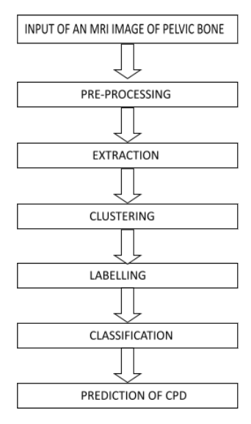
PROPOSED METHOD
The proposed approach focuses on image processing techniques such as pre-processing, extraction, clustering and classification.
The pre-processing is used to remove the unnecessary pixels from the image.
The extraction is used to extract the information from the pre-processed image.
Then clustering for making image clusters and
Classification is used to train the clustered data set.
The algorithm is based on filtering of MRI images(DICOM images) which is used for removing the noise over an image, segmented with filtering images, extracting the information from segmented images and getting the prediction using a trained data set.
Thu Jan 06 2022 00:13:04 GMT-0600 (Central Standard Time)

Slide 9
IMAGE PRE-PROCESSING
The pre-processing is to improve the image quality to make it ready for further processing by removing or reducing the unrelated and surplus parts in the background of the images which are medical images that are complicated to interpret.
It will prepare the mammogram for the next two-process feature extraction and clustering.
The noise and high frequency components removed by filters. It does not increase image information content. The methods use considerable redundancy in images.
Thu Jan 06 2022 00:13:04 GMT-0600 (Central Standard Time)

Slide 10
EXTRACTION
The pre-processed image is now ready to get the necessary data extracted.
Many DICOM SOP classes contain bulk pixel data, which is usually used to represent one or more image frames (although other types of data are possible).
In these SOP classes the pixel data is (almost) always contained in the (7FE0,0010) Pixel Data element. The only exception to this is Parametric Map Storage which may instead contain data in the (7FE0,0008) Float Pixel Data or (7FE0,0009) Double Float Pixel Data elements.
Therefore, we are going to use this pixel data which is basically a pixel array for our further work.
Thu Jan 06 2022 00:13:04 GMT-0600 (Central Standard Time)

Slide 11
CLUSTERING
Now that we have the pixel array for the whole dataset equipped with each patient data, we can now proceed with clustering.
It is basically a type of unsupervised learning method. An unsupervised learning method is a method in which we draw references from datasets consisting of input data without labeled responses.
Here, we are going to use K-means clustering which is one of the simplest and popular unsupervised machine learning algorithms.
We are using this unsupervised algorithm to get this dataset labeled into four category which is basically the four different types of pelvis bone.
Thu Jan 06 2022 00:13:04 GMT-0600 (Central Standard Time)

Slide 12
CLASSIFICATION
Now that we have labels decided we are going to use supervised image classification algorithm CNN(Convolutional Neural Network).
A Convolutional Neural Network (ConvNet/CNN) is a Deep Learning algorithm which can take in an input image, assign importance (learnable weights and biases) to various aspects/objects in the image and be able to differentiate one from the other.
The pre-processing required in a ConvNet is much lower as compared to other classification algorithms. While in primitive methods filters are hand-engineered, with enough training, ConvNets have the ability to learn these filters/characteristics.
Thu Jan 06 2022 00:13:04 GMT-0600 (Central Standard Time)

Slide 13
The following are the steps involved in building a classification model(Python):
Initialize the classifier to be used.
Train the classifier: All classifiers in scikit-learn uses a fit(X, y) method to fit the model(training) for the given train data X and train label y.
Predict the target: Given an unlabeled observation X, the predict(X) returns the predicted label y.
Evaluate the classifier model
Types of Classification Algorithms with the accuracy we are getting (Python):
Logistic Regression
Naïve Bayes
K-Nearest Neighbours
Support Vector Machine
Decision Tree
Random Forest
We are going to check the accuracy for each classification algorithm and use them accordingly.
Thu Jan 06 2022 00:13:04 GMT-0600 (Central Standard Time)

Slide 14
CONVOLUTIONAL NEURAL NETWORK(CNN)
After completing all these traditional classification we are going to use CNN to get the best accuracy.
The convolutional neural network (CNN) is a class of deep learning neural networks.
CNNs have an input layer, and output layer, and hidden layers. The hidden layers usually consist of convolutional layers, ReLU layers, pooling layers, and fully connected layers.
Thu Jan 06 2022 00:13:04 GMT-0600 (Central Standard Time)

Slide 15
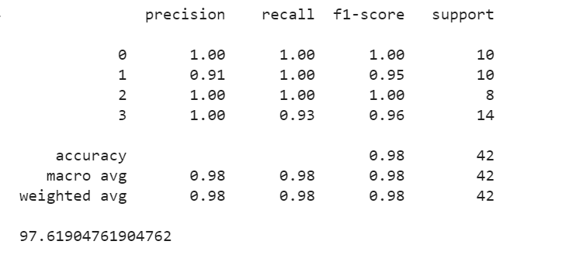
LOGISTIC REGRESSION
Thu Jan 06 2022 00:13:04 GMT-0600 (Central Standard Time)

Slide 16
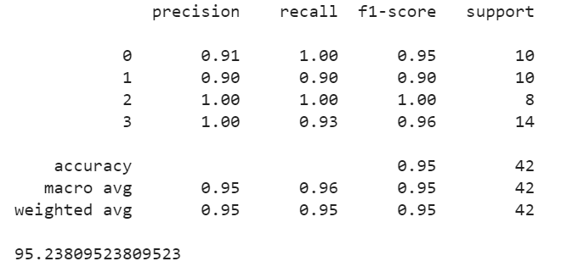
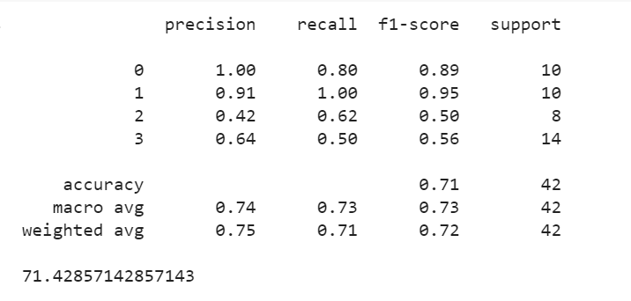
NAIVE BAYES
Gaussian naive bayes Bernouli naive bayes
Thu Jan 06 2022 00:13:04 GMT-0600 (Central Standard Time)

Slide 17
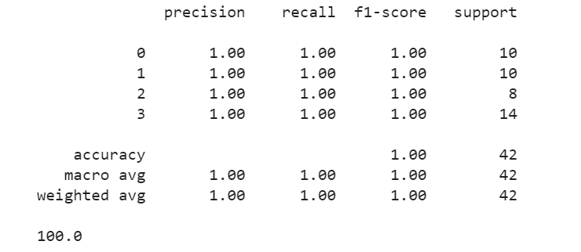
K-NEAREST NEIGHBOURS
Thu Jan 06 2022 00:13:04 GMT-0600 (Central Standard Time)

Slide 18
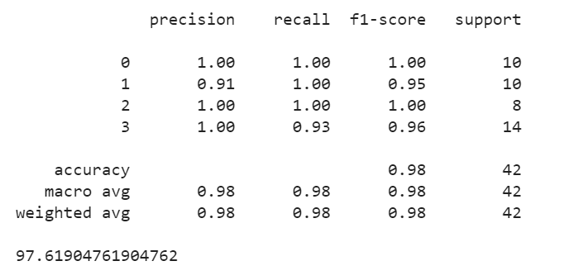
SUPPORT VECTOR MACHINES
Thu Jan 06 2022 00:13:04 GMT-0600 (Central Standard Time)

Slide 19

DECISION TREE
Thu Jan 06 2022 00:13:04 GMT-0600 (Central Standard Time)

Slide 20
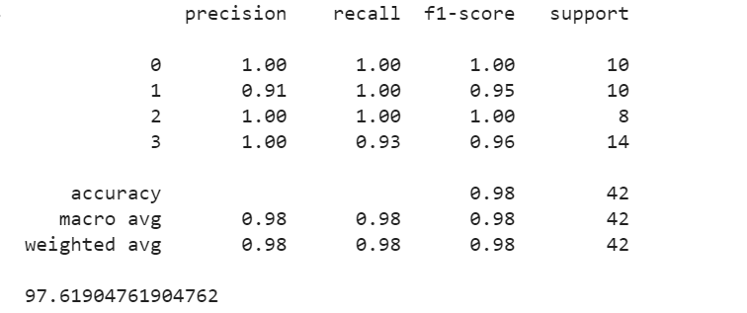
RANDOM FOREST
Thu Jan 06 2022 00:13:04 GMT-0600 (Central Standard Time)

Slide 21
FUTURE WORK
As these are sensitive medical images we are working on we are expecting above 95% accuracy and we are getting so. However, we need to consider this during implementing CNN.
We also want to verify the cluster from a doctor to find out which one is Android pelvis type as Android is having more tendency to cause CPD.
We are also targeting to make this public by making a website where anyone can give their MRI as input and we should be able to calculate the chance of having CPD.
Thu Jan 06 2022 00:13:04 GMT-0600 (Central Standard Time)

Slide 22
REFERENCES
Anthropometric measurements as predictors of cephalopelvic disproportion by Santosh J Benjamin, Anjali B Daniel, Asha Kamath, Vani Ramkumar, Published on 5th September 2011
https://obgyn.onlinelibrary.wiley.com/doi/full/10.1111/j.1600-0412.2011.01267.x
Anthropometric measurements as predictors of cephalopelvic disproportion: Can the diagnostic accuracy be improved? by Santosh J Benjamin, Anjali B Daniel, Asha Kamath, Vani Ramkumar, published on 13th October 2013
https://pubmed.ncbi.nlm.nih.gov/21895610/
Study of anthropometric measurements to predict contracted pelvis by Deepika N, Arun Kumar and Shivagami C, Published on 17th December, 2018
https://www.gynaecologyjournal.com/articles/172/2-6-23-590.pdf
Anthropometric measurements as predictors of cephalopelvic disproportion by S. Benjamin, A. Daniel, A. Kamath, V. Ramkumar, published on 2012
https://www.semanticscholar.org/paper/Anthropometric-measurements-as-predictors-of-Benjamin-Daniel/0a6c5834490ce98c6f2795b0a717037fd8228011
Thu Jan 06 2022 00:13:04 GMT-0600 (Central Standard Time)

Slide 23
Safety of Radiographic Imaging During Pregnancy by Kevin S. Toppenberg, M.d., D. Ashley Hill, M.d., And David P. Miller, Published on 1st April 1999
https://www.aafp.org/afp/1999/0401/p1813.html
Pelvimetry revisited: Analyzing cephalopelvic disproportion by Miriam S.Lenhard, Thorsten R.C. Johnson, Sabine Weckbach, Konstantin Nikolaou, Klaus Friesea, Uwe Hasbargen, Published on June 2010
https://www.sciencedirect.com/science/article/abs/pii/S0720048X09002423
Three-dimensional camera anthropometry to assess risk of cephalopelvic disproportion-related obstructed labour in Ethiopia by Lorenzo Tolentino, Mahlet Yigeremu, Sisay Teklu, Shehab Attia, Michael Weiler, Nate Frank, J. Brandon Dixon and Rudolph L. Gleason, Published on 16th August 2019
https://royalsocietypublishing.org/doi/full/10.1098/rsfs.2019.0036
https://www.healthline.com/health/types-of-pelvis
https://www.birthinjuryhelpcenter.org/cephalopelvic-disproportion.html
https://americanpregnancy.org/healthy-pregnancy/labor-and-birth/cephalopelvic-disproportion/
https://www.abclawcenters.com/practice-areas/prenatal-birth-injuries/traumatic-birth-injuries/cephalopelvic-disproportion/
https://www.beckerjustice.com/causes-of-birth-injury/cephalopelvic-disproportion-cpd-/
https://www.urmc.rochester.edu/encyclopedia/content.aspx?contenttypeid=197&contentid=28587
Thu Jan 06 2022 00:13:04 GMT-0600 (Central Standard Time)

Slide 24
Thank You
Thu Jan 06 2022 00:13:04 GMT-0600 (Central Standard Time)

